Slide 1

JAWAHARLAL NEHRU UNIVERSITY,DELHI SCHOOL OF COMPUTER & SYSTEM SCIENCES
NAME – HARSHITA CHOURASIYA
ENROLLMENT NO.- 21/10/JC/035
SUBJECT-PROGRAMMING IN C (CS-401)
PROJECT TOPIC- TIC TAC TOE GAME
SUMBITTED TO- DR. PIYUSH PRATAP SINGH SIR

Slide 2
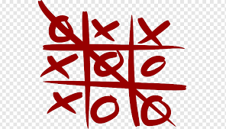
TIC TAC TOE GAME
Tic tac toe ,noughts and crosses or Xs and Os is a paper pencil game for two players who take turns marking the spaces in n*n grid with X or O . I have tried to design this game using C programming and uses 3*3 grid in it. The player who succeeds in placing three of their marks in horizontal, vertical or diagonal row is the winner and in case if none of the player placed three of their marks then draw occurs.

Slide 3
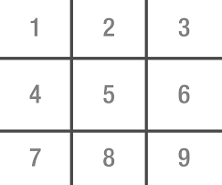
Function used in program
board()
This function is Created for the appearance of the Game and to inform that for Player 1 X is given and for Player 2 O is given.
Player 1 (X) - Player 2 (O)

Slide 4
main()
In main function player is initialized as 1 so the game started with player 1 .then Do while loop is applied so that the board display first then it take value from the loop and change it accordingly. and there is condition given to check whether the player is 1 or 2 .If it a player 1 then the number selected by the player 1 turns to be X. and for player 2 it turns into 0. and every time when player select any number it checks the winning condition too by calling checkwin function.
| |
1 | X | 3
___|__ |_____
| |
4 | O | 6
___|___|_____
| |
7 | 8 | 9
| |
Player 1, enter a number:
Player 1 select the number 2 and therefore it turns into cross in place of 2
Player 2 selects the number 5 ,therefore it turns into zero in place of 5
Again it ask for the choice because the loop continues until the checkwin condition gives the winner or declared draw

Slide 5
checkwin()
In this Function all the condition are given using if else loop for winning the game .And operation is also used for checking two condition simultaneously.
It checks horizontally, vertically and diagonally three of their marks.
And in last the draw condition is Given .
| |
X | O | X
__ |___ |_____
| |
O | X | X
___|__ |_____
| |
O | X | O
| |
==>Game draw
| |
X | O | O
__ |___|_____
| |
4 | X | 6
___|___ |_____
| |
7 | 8 | X
| |
==>Player 1 win

Slide 6
THANKYOU

